Slide 1
MVP: Smart Lamp
Brian Mungal

Slide 2

What am I doing?
My goal is to create a smart lamp that helps people with anxiety, sleep disturbances, and trouble focusing
Incorporating skills from computer science and engineering
Exploring new areas: coding, hardware, 3D Modeling
Using lighting to help manage mood

Slide 3
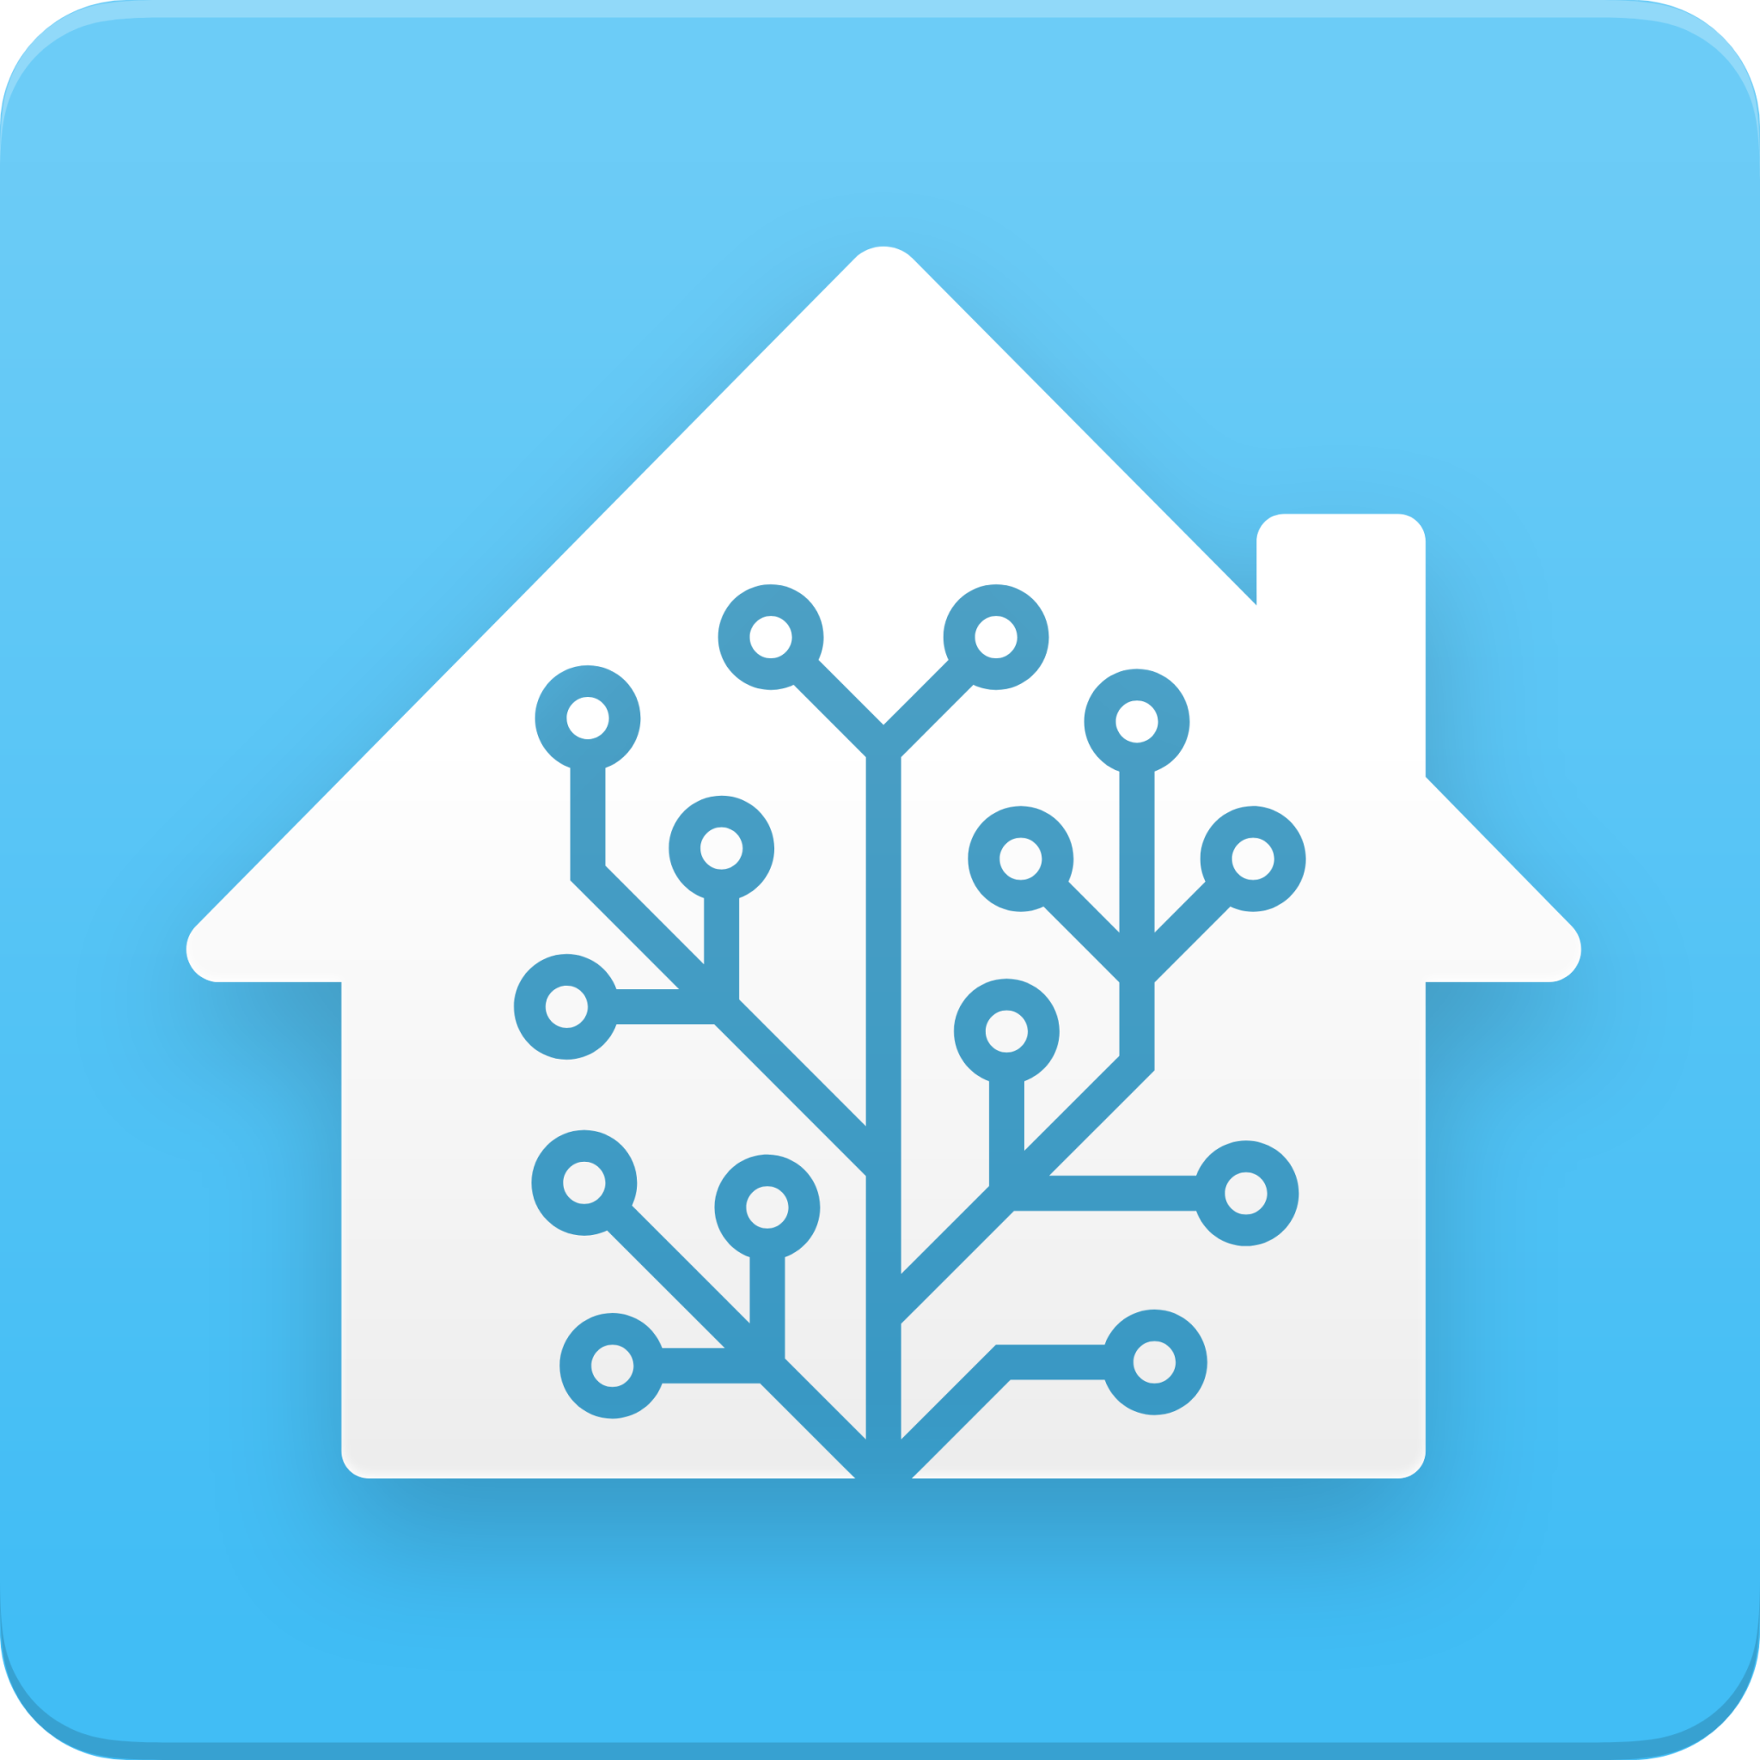
What is Home Assistant
HA allows users to control smart devices from a single dashboard
I’m using HA as an API
HA will connect my two Raspberry Pi’s and allow them to communicate between each other
One Pi is loaded with an image of HA OS that has MQTT or a comm system for machines
Second Pi executes python code and runs the circuit

Slide 4
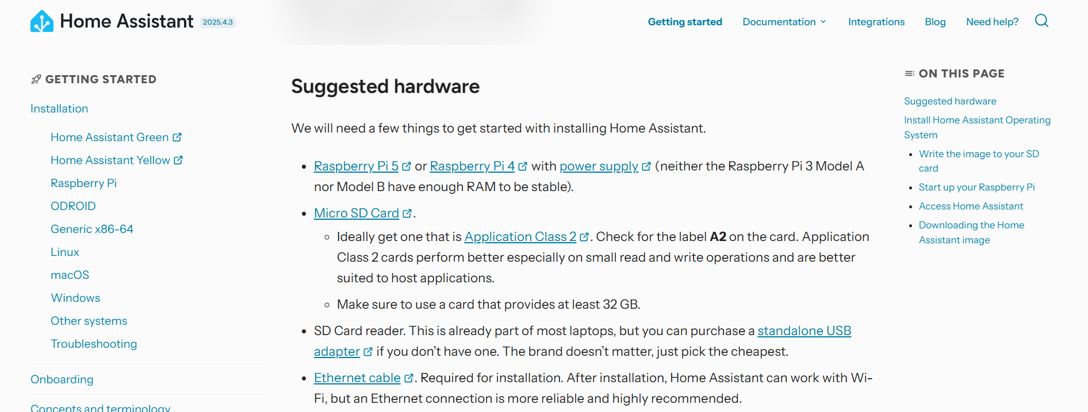

Slide 5
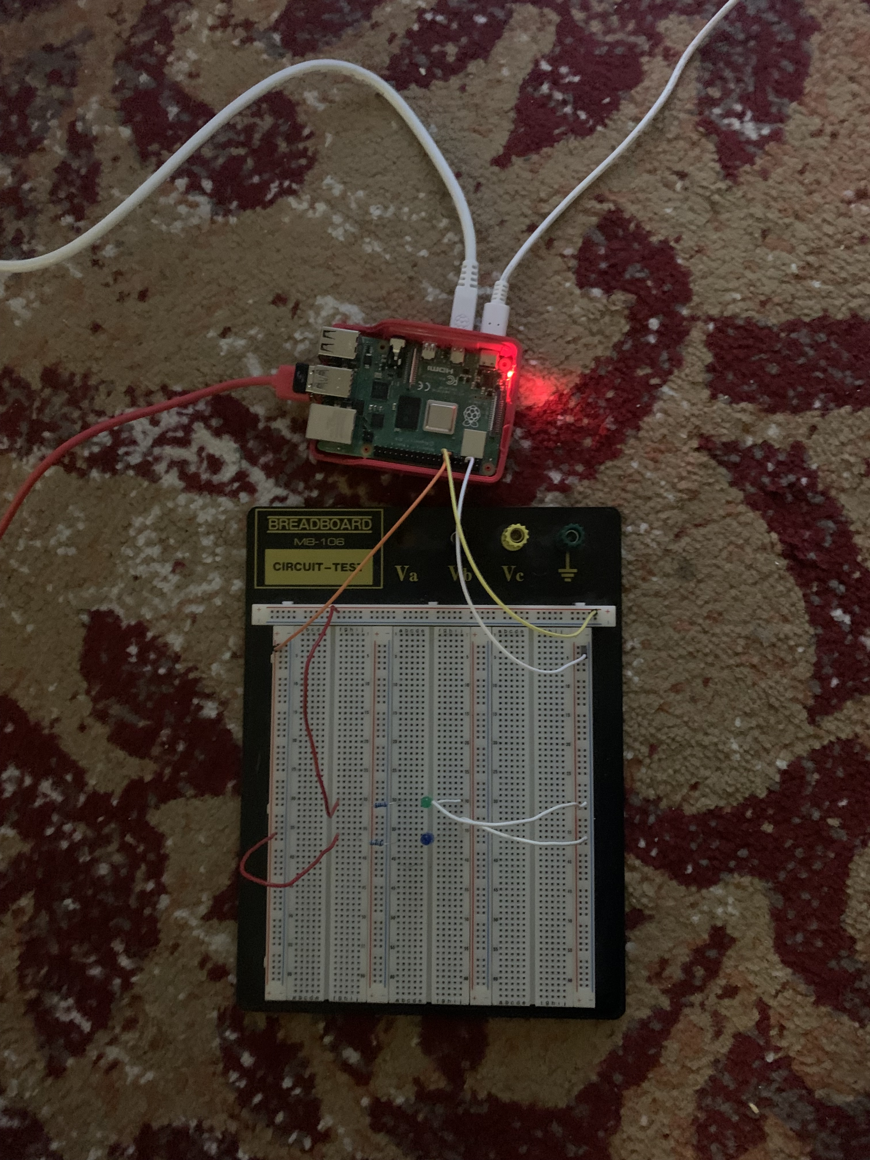
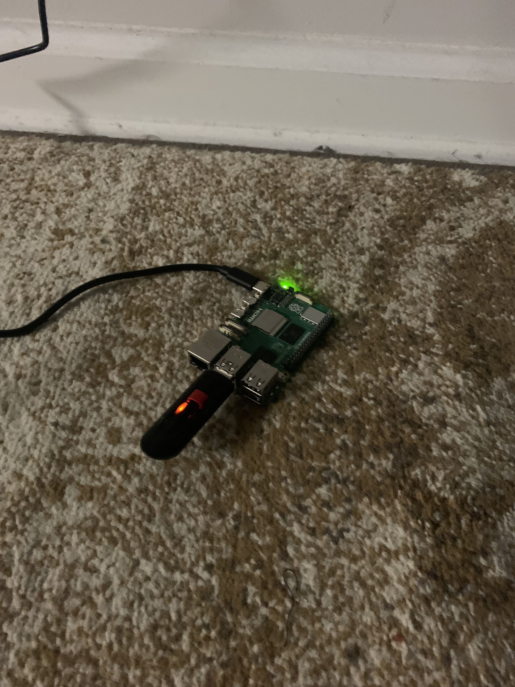
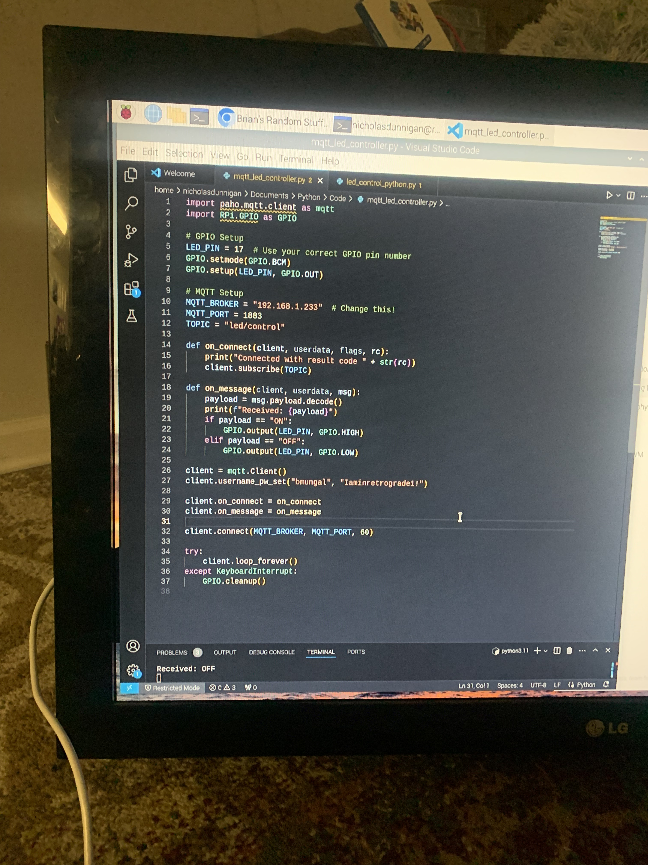
Hardware and code

Slide 6
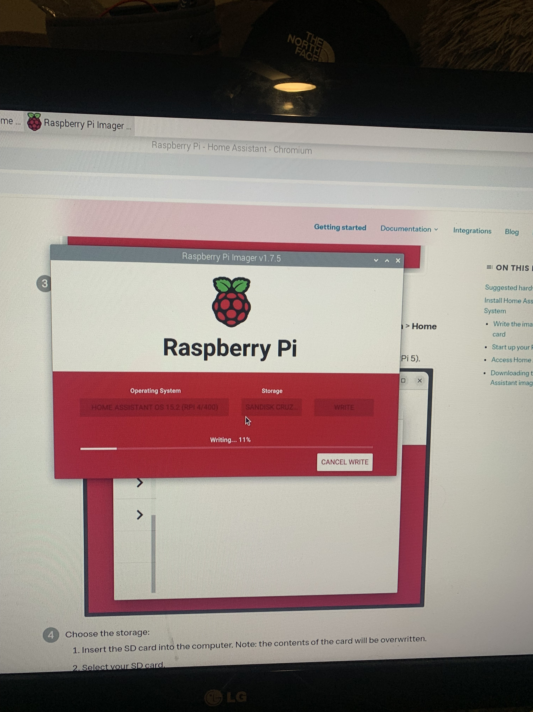
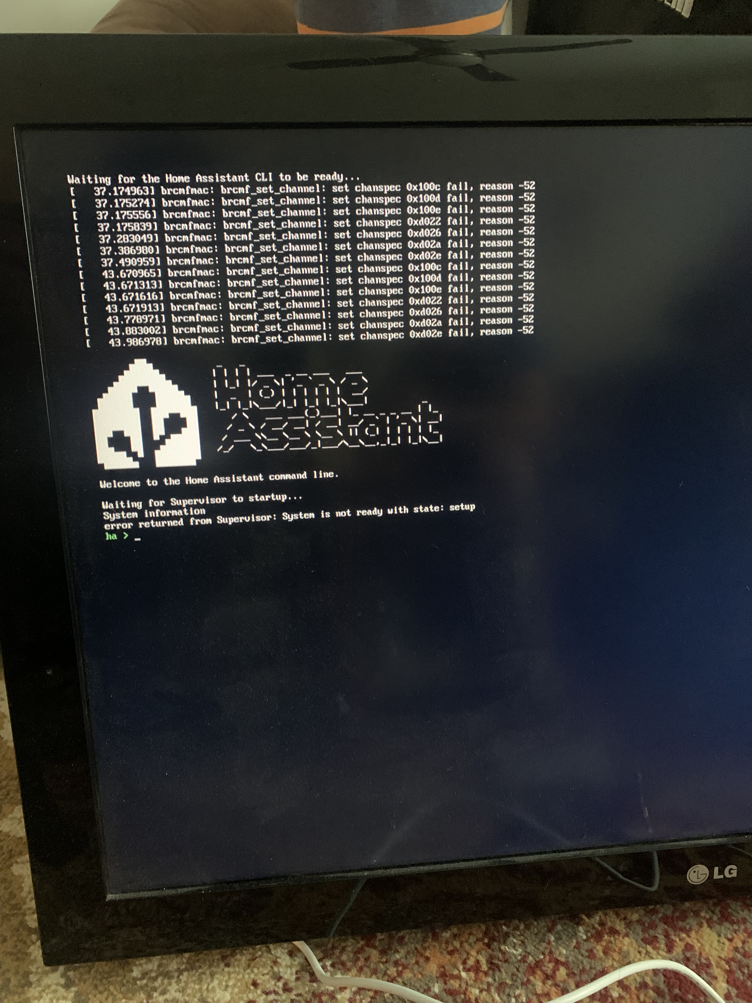
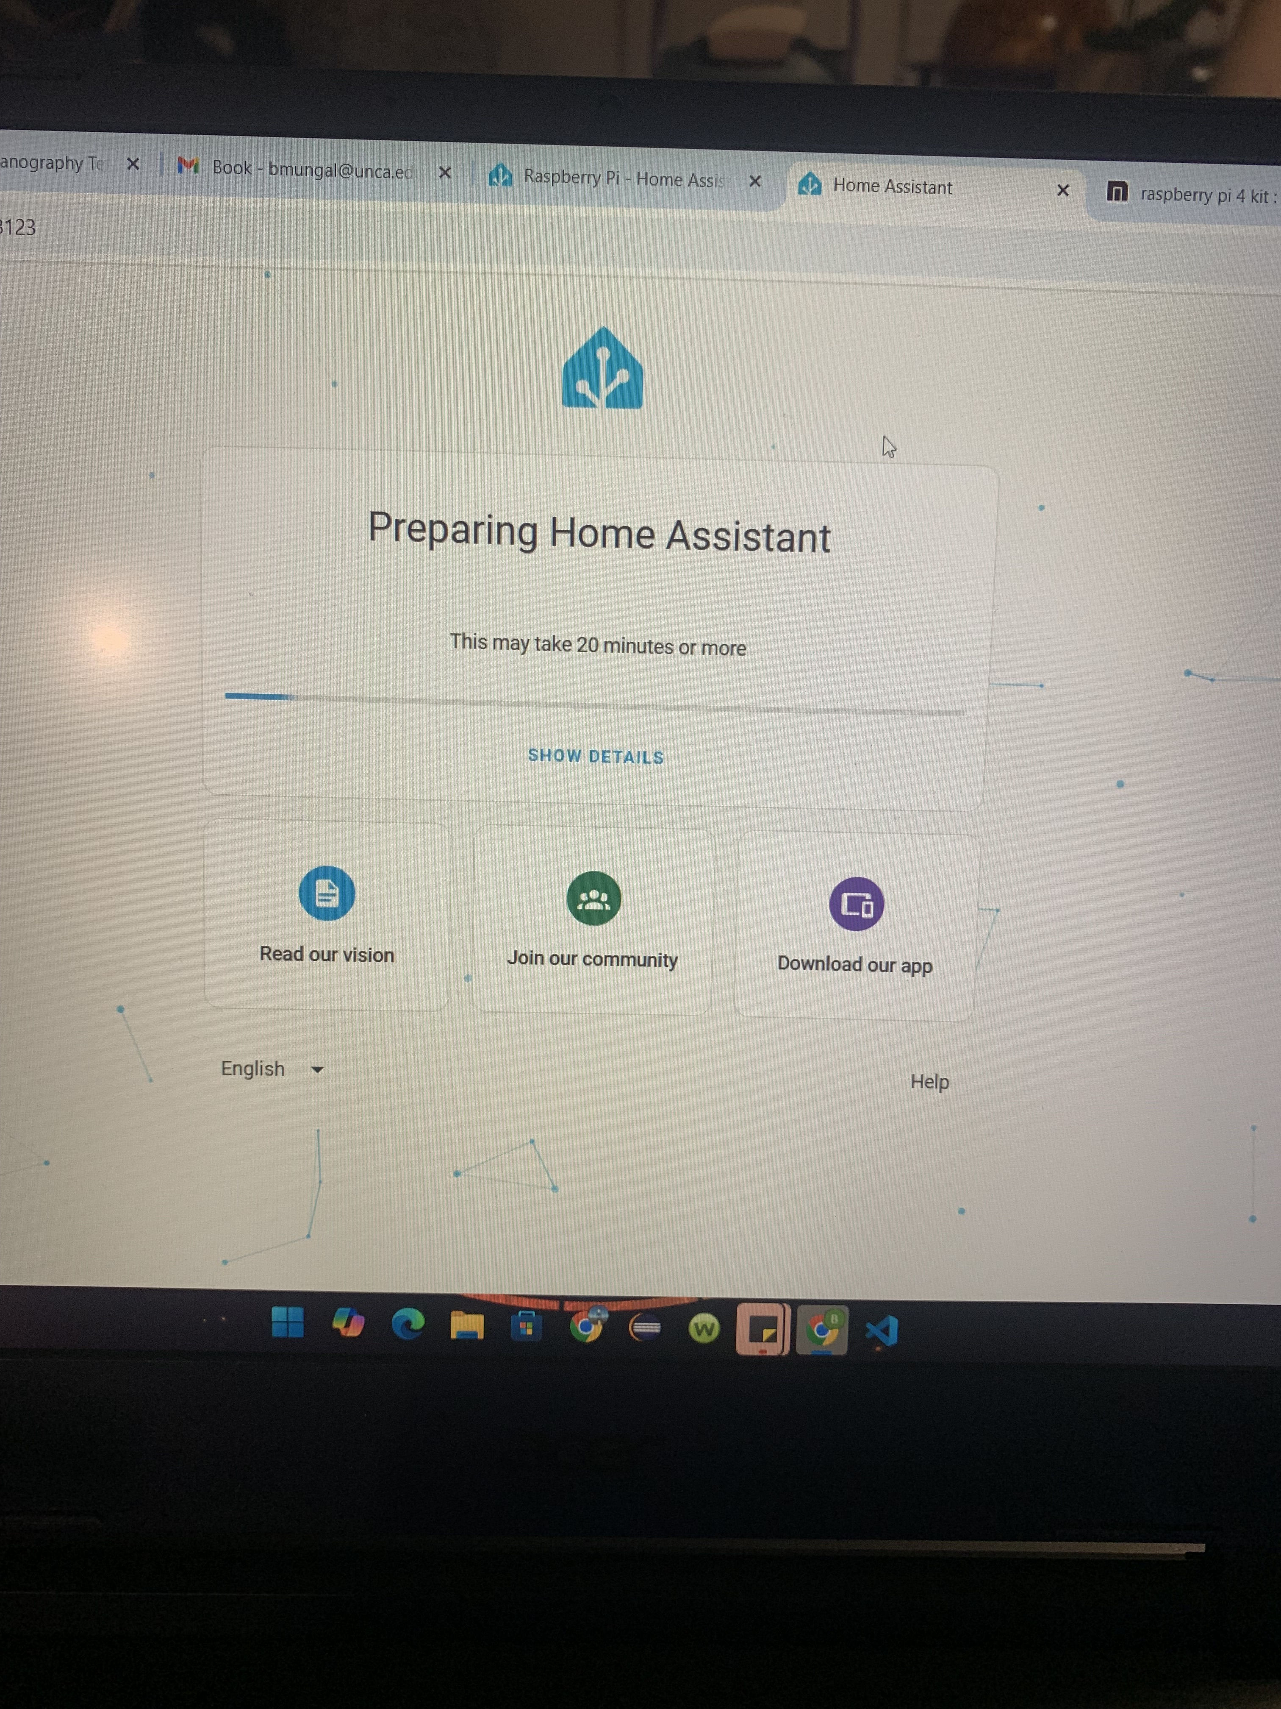
Setting up Home Assistant

Slide 7
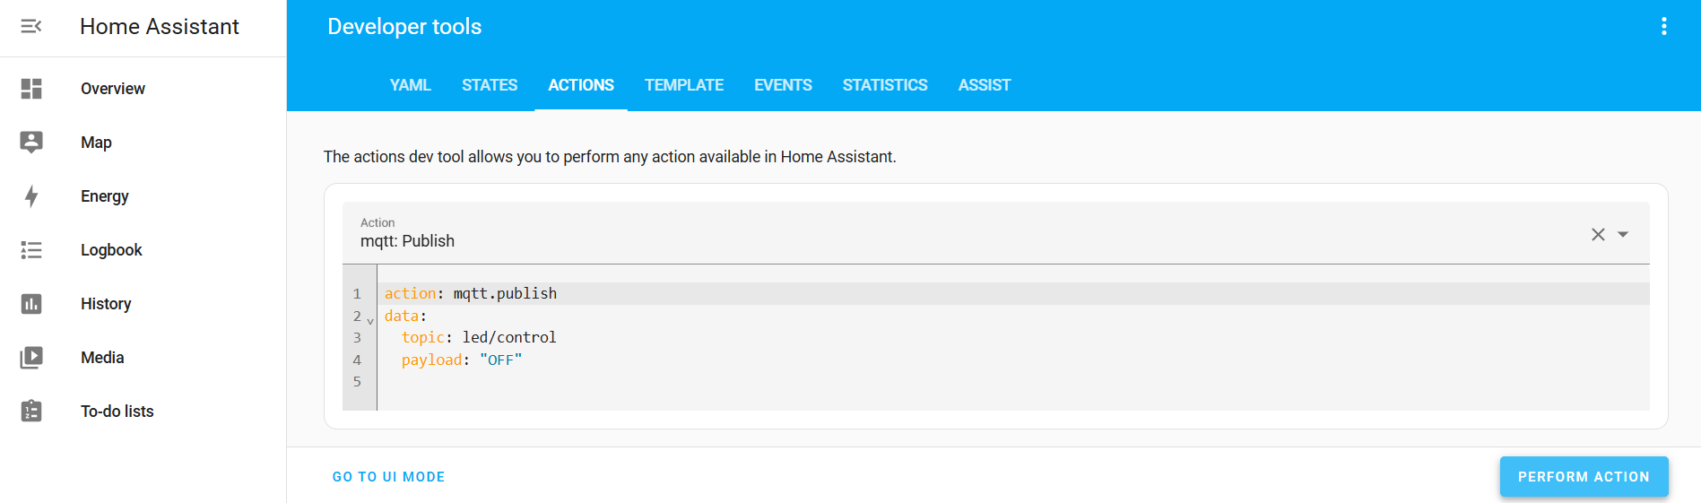
Sending commands

Slide 8

Challenges
Raspberry Pi: I needed 2, one to hold Image of HA OS and 1 to run commands
Flashing 2 Raspberry Pi’s: Flashing and overriding the OS was time consuming (3-5 hours TWICE)
Running commands on HA: I couldn’t test/ listen to commands that were run on the HA dashboard, I wrote test scripts and ran them live
HA Comms: finding the correct port number, make sure the device was listening, connecting to the same network, creating a script to login that also had network information

Slide 9
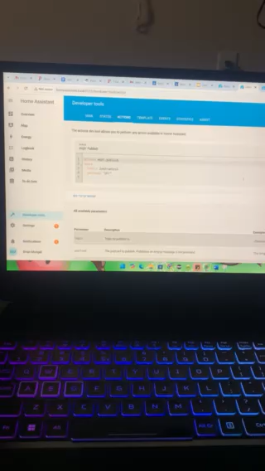
HA in Action

Slide 10
Thank You

